Slide 1
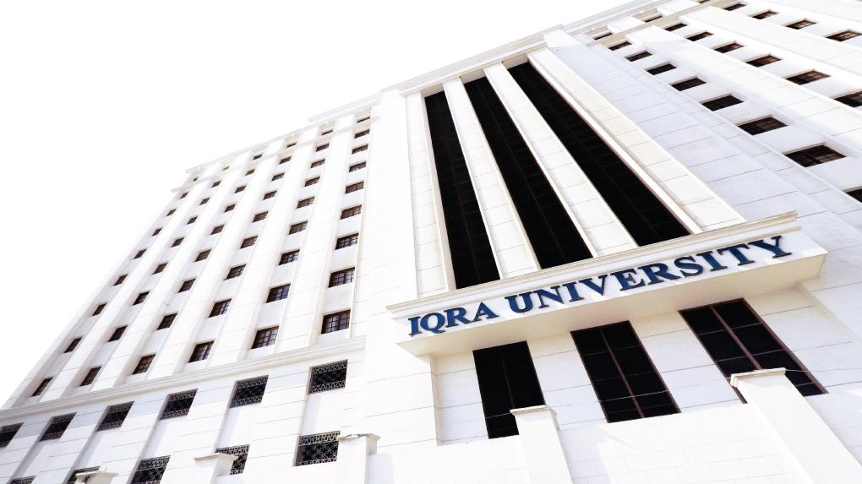

Sequence and Series
LECTURE 9
Adapted from :
https://www.genrica.com/vustuff/MTH202/MTH202_handouts_1_45.pdf

Slide 2
Learning Outcomes
After completing this lecture satisfactorily, a student will:
Acquire ability to describe computer programs (e.g. recursive
functions) in a formal mathematical manner.
• Be able to apply basic counting techniques to solve combinatorial
problems.

Slide 3
SEQUENCE
A sequence is just a list of elements usually written in a row.
EXAMPLES:
1. 1, 2, 3, 4, 5, …
2. 4, 8, 12, 16, 20,…
3. 2, 4, 8, 16, 32, …
4. 1, 1/2, 1/3, 1/4, 1/5, …
5. 1, 4, 9, 16, 25, …
6. 1, -1, 1, -1, 1, -1, …
NOTE:
The symbol “…” is called ellipsis, and reads “and so forth”

Slide 4
NOTATION:
We use the notation a_{n} to denote the image of the integer n, and call it a term of the sequence. Thus
a₁, a₂, a₃, a₄ …, a_{n}, …
represent the terms of a sequence defined on the set of natural numbers N.
Note that a sequence is described by listing the terms of the sequence in order of increasing subscripts.
EXAMPLE:
Write the first four terms of the sequence defined by the formula
bj = 1 + 2^{j}, for all integers j ≥ 0
SOLUTION:
b₀ = 1 + 2⁰ = 1 + 1 = 2
b₁ = 1 + 2¹ = 1 + 2 = 3
b₂ = 1 + 2² = 1 + 4 = 5
b₃ = 1 + 2³ = 1 + 8 = 9

Slide 5
EXERCISE:
Compute the first six terms of the sequence defined by the formula C_{n} = 1+ (-1) ^{n} for all integers n ≥ 0
SOLUTION :
C₀ = 1 + (-1) ⁰= 1 + 1 = 2 C₁ = 1 + (-1)¹ = 1 + (-1) = 0
C₂ = 1 + (-1)² = 1 + 1 = 2 C₃ = 1 + (-1)³ = 1 + (-1) = 0
C₄ = 1 + (-1)⁴ = 1 + 1 = 2 C₅ = 1 + (-1)⁵ = 1 + (-1) = 0

Slide 6
ARITHMETIC SEQUENCE:
A sequence in which every term after the first is obtained from the preceding term by adding a constant number is called an arithmetic sequence or arithmetic
progression (A.P.)
The constant number, being the difference of any two consecutive terms is called
the common difference of A.P., commonly denoted by “d”.
EXAMPLES:
1. 5, 9, 13, 17, … (common difference = 4)
2. 0, -5, -10, -15, … (common difference = -5)
3. x + a, x + 3a, x + 5a, … (common difference = 2a)

Slide 7
GENERAL TERM OF AN ARITHMETIC SEQUENCE:
Let a be the first term and d be the common difference of an arithmetic sequence. Then the sequence is a, a+d, a+2d, a+3d, …
If a_{i}, for i ≥ 1, represents the terms of the sequence then
a₁ = first term = a = a + (1-1) d
a₂ = second term = a + d = a + (2-1) d
a₃ = third term = a + 2d = a + (3 -1) d
By symmetry
a_{n} = nth term = a + (n - 1)d for all integers n ≥1.
EXAMPLE:
Find the 20th term of the arithmetic sequence
3, 9, 15, 21, …
SOLUTION:
Here a = first term = 3
d = common difference = 9 - 3 = 6
n = term number = 20
a₂₀ = value of 20th term = ?
Since a_{n} = a + (n - 1) d; n ≥1
∴ a₂₀ = 3 + (20 - 1) 6
= 3 + 114
= 117

Slide 8
EXERCISE:
Find the 36th term of the arithmetic sequence whose 3rd term is 7 and 8th term is 17.
SOLUTION:
Let a be the first term and d be the common difference of the arithmetic sequence.
Then
a_{n} = a + (n - 1)d n ≥ 1
⇒ a₃ = a + (3 - 1) d
and a₈ = a + (8 - 1) d
Given that a₃ = 7 and a₈ = 17. Therefore
7 = a + 2d……………………(1)
and 17 = a + 7d………….………..(2)
Subtracting (1) from (2), we get,
10 = 5d
⇒ d = 2

Slide 9
Substituting d = 2 in (1) we have
7 = a + 2(2)
which gives a = 3
Thus, a_{n} = a + (n - 1) d
a_{n} = 3 + (n - 1) 2 (using values of a and d)
Hence the value of 36th term is
a₃₆ = 3 + (36 - 1) 2
= 3 + 70
= 73

Slide 10
GEOMETRIC SEQUENCE:
A sequence in which every term after the first is obtained from the preceding term by multiplying it with a constant number is called a geometric sequence or geometric progression (G.P.)
The constant number, being the ratio of any two consecutive terms is called the common ratio of the G.P. commonly denoted by “r”.
EXAMPLE:
1. 1, 2, 4, 8, 16, … (common ratio = 2)
2. 3, - 3/2, 3/4, - 3/8, … (common ratio = - 1/2)
3. 0.1, 0.01, 0.001, 0.0001, … (common ratio = 0.1 = 1/10)

Slide 11
GENERAL TERM OF A GEOMETRIC SEQUENCE:
Let a be the first tem and r be the common ratio of a geometric sequence. Then the sequence is a, ar, ar², ar³, …
If a_{i}, for i ≥ 1 represent the terms of the sequence, then
a₁ = first term = a = ar¹⁻¹
a₂ = second term = ar = ar²⁻¹
a₃ = third term = ar² = ar³⁻¹
………………
………………
a_{n} = nth term = ar^{n-1}; for all integers n ≥ 1

Slide 12
EXAMPLE:
Find the 8th term of the following geometric sequence
4, 12, 36, 108, …

Slide 13
EXAMPLE:
Which term of the geometric sequence is 1/8 if the first term is 4 and common ratio ½

Slide 14
EXERCISE:
Write the geometric sequence with positive terms whose second term is 9 and fourth term is 1.

Slide 15
Review Questions
Can you explain between sequence and series.
Define Arithmetic sequence.

Slide 16
Thank you

